Slide 1


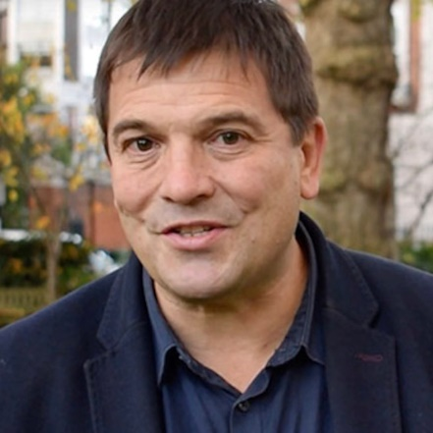
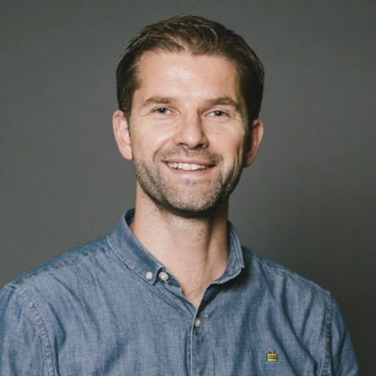
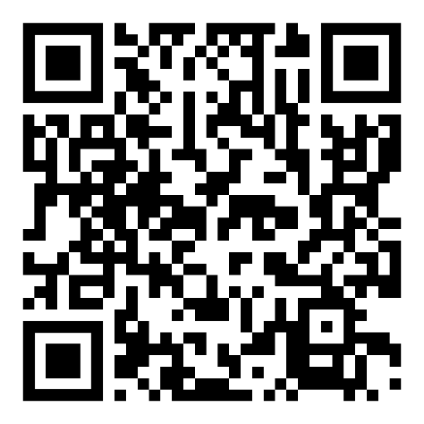
EQUIP 2025
Thu 2nd, Fri 3rd & Sat 4th October
“To Boldly Go! The Call of Mission in Wales Today”
7:30pm (or online from 8pm), Thu 2nd Oct - New House Country Hotel, Cardiff
“Extraordinary in the Ordinary” - An evening event for women
12:30pm, Fri 3rd Oct - Union School of Theology, Bridgend
“Self – Leadership” with Rico Tice
7:30pm, Fri 3rd Oct - Hope Church Merthyr
“Mobilising the local church for evangelism” with Rico Tice
“From football to faith” with Kristian Diamond
9am, Sat 4th Oct - Glenwood Church, Cardiff
“EQUIP 2025 morning conference”
with Rico Tice and Andrew Ollerton
Booking now open!
Rico Tice
Andrew Ollerton
Find out more & book your place: wlf.org.uk/equip

