Slide 1
Anxiety
EQUIP network:
Christian Soul care

Slide 2
Session 1
Minds conformed to the world

Slide 3
What is an ‘emotional disorder’?
‘ ..a mental disorder not caused by detectable organic abnormalities of the brain and in which a major disturbance of emotions is predominant.
Two broad categories:
Mood Disorders are characterized by emotions that are not appropriate to a given situation.
Anxiety Disorders are characterised by an individual remaining in a persistent state of anxiety for an extended period of time.
The individual's daily life will be disrupted to a sufficient extent, by distorted emotions, thoughts and behaviours, they are left unable to fully function in the world’

Slide 4
Romans 12:2 (NIV)
‘Do not conform to the pattern of this world, but be transformed by the renewing of your mind’

Slide 5
Understand the person
Saint
Sinner
Sufferer
The world
The devil
The flesh

Slide 6
Creation
Image bearers
Fall
Distorted image bearers
Redemption
A child of God
Glorification
Male & female
Embodied
Relational
Worshippers
We sin
We suffer
We worship idols
Pursued and chosen
Being changed
Free & secure
Tempted
Tested
New creations ‘In Christ’
We will be like Him in the New Creation
Who we are in God’s big story

Slide 7
Understand the label
Bi-polar
Gender dysphoria
GAD
Panic attacks
Anxiety attacks
Social Anxiety Disorder
Eating Disorders
Body dysmorphic disorder
Phobias
PTSD
OCD
Borderline disorder

Slide 8
Understand the medication
Citalopram (Celaxa)
Sertraline (Zoloft)
Fluoxetine (Prozac)
Diazepam (Valium)
They calm emotions by modifying chemicals in the brain – but they don’t cure the underlying condition.
Propranolol

Slide 9
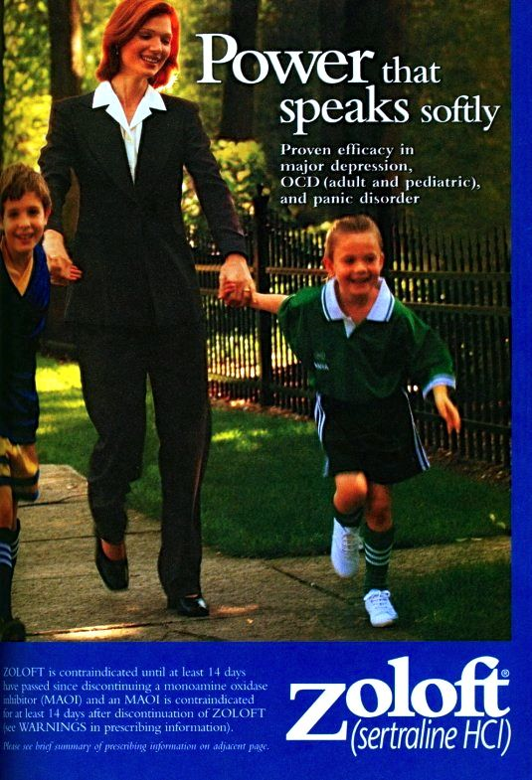

Slide 10
Drug effectiveness

Slide 11
Understand the therapy
Rejected outright or embraced unquestioningly?
CBT & mindfulness are probably the two most commonly referred helps for emotional disorder
Can you help someone to wisely consider them biblically?
Work alongside medical professionals
Have you got the relevant MH numbers in your safeguarding policy?

Slide 12
Understand the risk
Suicide awareness – risk factors ‘SAD PERSONS’
Sex | Females are more common (x3) men are more successful (7 out of 10)
Age | Adolescents and elderly facing chronic illness
Depression | Or other serious psychiatric diagnosis
Previous attempt* | Risk is immediately much higher
Ethanol abuse | Alcohol or drug abuse
Rational thought* | Psychosis or delusions
Social support | Person is isolated with little supportive community
Organised plan** | Degree of planning is highly significant
No spouse | Divorced, bereaved, separated or single
Sickness is chronic | Severe, chronic or debilitating illness

Slide 13
Understand the risk
Suicide awareness – risk factors ‘NO HOPE’
No framework* | Sees suffering as meaningless and hopeless
Overt change | In physical or emotional condition
Hostile interpersonal relationships | Presence of destructive conflict or abuse
Out of hospital | Recent psychiatric discharge
Predisposing personality factors | Emotionally volatile
Excuses or reasons for dying | Strongly believe they are pointless/useless

Slide 14
Understand the risk
Suicide awareness – protective factors
Strong religious faith
Family support
Children at home
Sense of responsibility
Problem solving skills
Don’t be afraid to say the ‘s’ word and ask the question…….
‘With all that’s happened, I’m just wondering if you’ve had desires to kill yourself, even if they’re fleeting?’

Slide 15
God’s big spectrum
The is no them and us
Judgment becomes empathy
‘You’ becomes ‘we’
Complexity is simplified through scripture
‘Abnormal in a normal world’ becomes ‘normal in an abnormal world’
Fallen Image Bearers

Slide 16
Session 2
Minds conformed to the WORD

Slide 17
How does the world see emotions? An emotion is a cognitive (mental) reaction experienced as strong feeling. It is usually directed toward a specific situation & is accompanied by physiological and behavioural changes But how do we consider emotions biblically?

Slide 18
A biblical view of emotions They reflect our image bearing status of God They are ‘fallen’ They are a powerful language which forces us and others to listen and respond. They provide invaluable communication about the real us (our heart) They communicate at two levels, on the horizontal towards others and on the vertical towards God.

Slide 19
What is anxiety?
What is anxiety?
F.E.A.R It is an emotion rooted in future-oriented thinking which incorporates themes of threat and vulnerability. Faced with an uncertain outcome, it overestimates the threat and underestimates your ability to cope.
Biblically it exposes the covenantal leanings of our active hearts

Slide 20
We are embodied souls

Slide 21
Anxiety involves all of us
Behaviours | Biology
Physical & Emotional withdrawal Ritualistic behaviours Unhelpful attempts to numb or control emotions (drugs, alcohol, self-harm, food restriction, pornography) Constant reassurance seeking | Fast heart rate (increased blood pressure) Over-breathing & dizziness ‘fuzzy brain’ – unable to make decisions / focus Poor sleep / twitch dropping off Butterflies / tense stomach / unable to eat / IBS Cold extremities
Thoughts | Heart
How we think is distorted… ‘I can’t cope’ ‘But what if…..’ ‘I think it’s serious – I googled it!’ ‘It will be terrible, I can’t stand it’ And what we think is distorted… About ourselves, others & God | Motivated by a functional belief that I am vulnerable and in danger, therefore I must protect myself. What is this revealing about our true beliefs concerning God?

Slide 22
HOW we think is distorted
All-or-nothing Everything is seen at an extreme, with no middle ground | Emotional Reasoning A situation is evaluated on the basis of how we feel about it
Over-generalisation Believing we know future outcomes based on a single event | Overly-demanding Holding unreasonable expectations in the form of Should / Must / Ought
Mental filtering We focus only on certain types of evidence about the situation or person | Personalisation / Blame Blaming ourselves for something not our fault / or blaming others for something which was
Mind reading / Fortune telling We believe we know what people are thinking / that the worst-case scenario will happen | Magnification or Minimisation Seeing something out of proportion or reducing its significance
And WHAT with think is distorted…about ourselves, about others and about God

Slide 23
We have to consider the heart -
Proverbs 4:23 Above all else, guard your hear, for everything you do flows from it.
Luke 6:45 For the mouth speaks what the heart is full of
Matthew 6:21 For where your treasure is, there your heart will be also
Mark 7:21 For it is from within, out of a person’s heart, that [evil] thoughts come
Preference
Need
Demand
God’s will
be done
My will be done
Anxiety is a Dysfunctional Worship Disorder
What are we really living for (worshipping) in that moment of fear?

Slide 24
We choose where we turn in the midst of anxiety
Become more isolated
Pleasure lost in life
Unable to work
Marriage strained
-Anxiety
-Avoidance / checking behaviours
-Chest pains / dizziness / panic attacks
Desire for self-protection (because God can’t / won’t)
This diagram is a publication of the Christian Counseling & Educational Foundation (CCEF). All content is protected by copyright and may not be reproduced in any manner without written permission from CCEF. For more information on classes, materials, speaking events, distance education and other services, please visit www.ccef.org.

Slide 25
You are not their Holy Spirit! Paul Tripp ‘Instruments’ p250

Slide 26
When renewing the mind is hard
Encouraging rational and logical thinking doesn’t usually work
Nor do ‘biblical platitudes’ or applying the ‘doctrine of JDI’
Make things concrete and visual and concrete can help connect them to scripture
Write out a lament of their fears – connect to God
Speak it out as a prayer
Some illustrative case studies…….

Slide 29
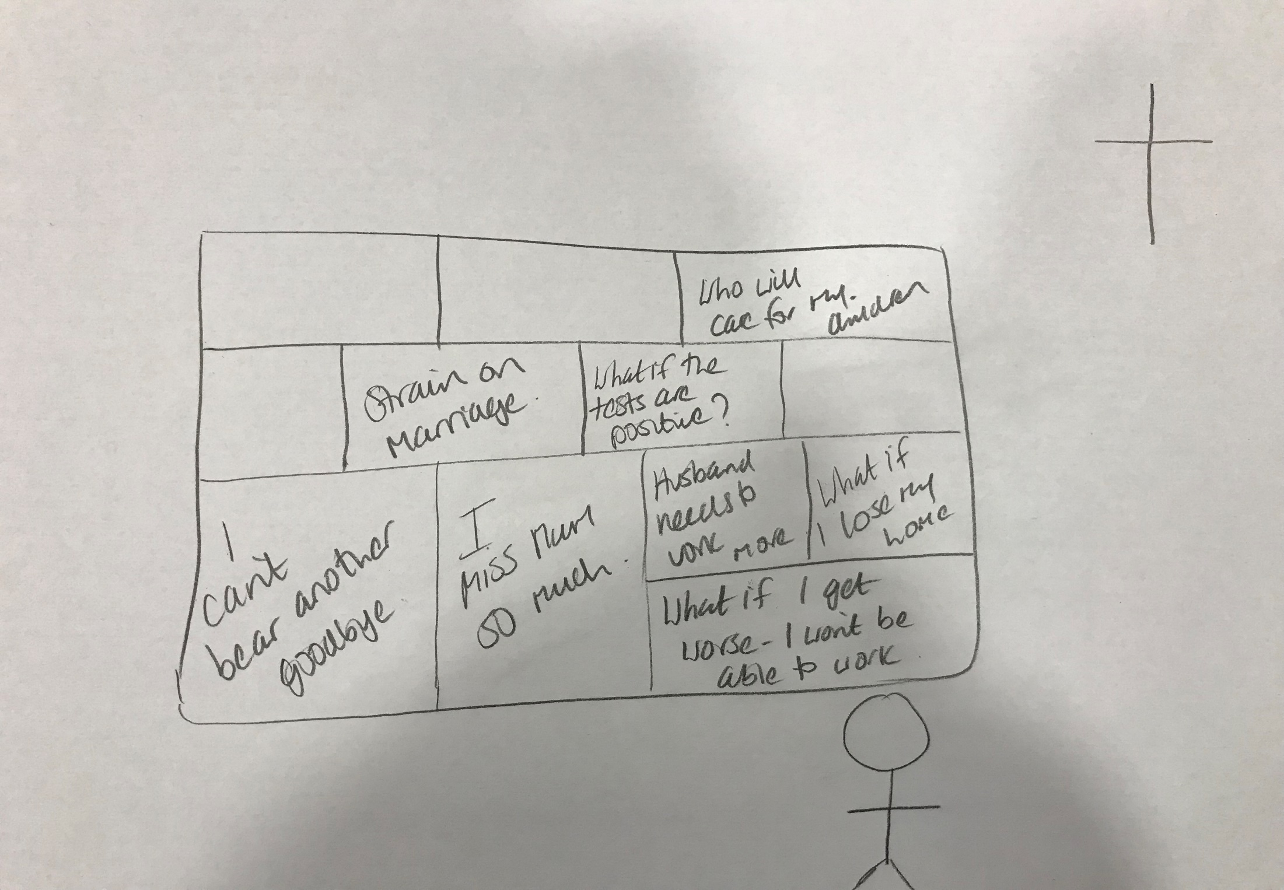

Slide 30
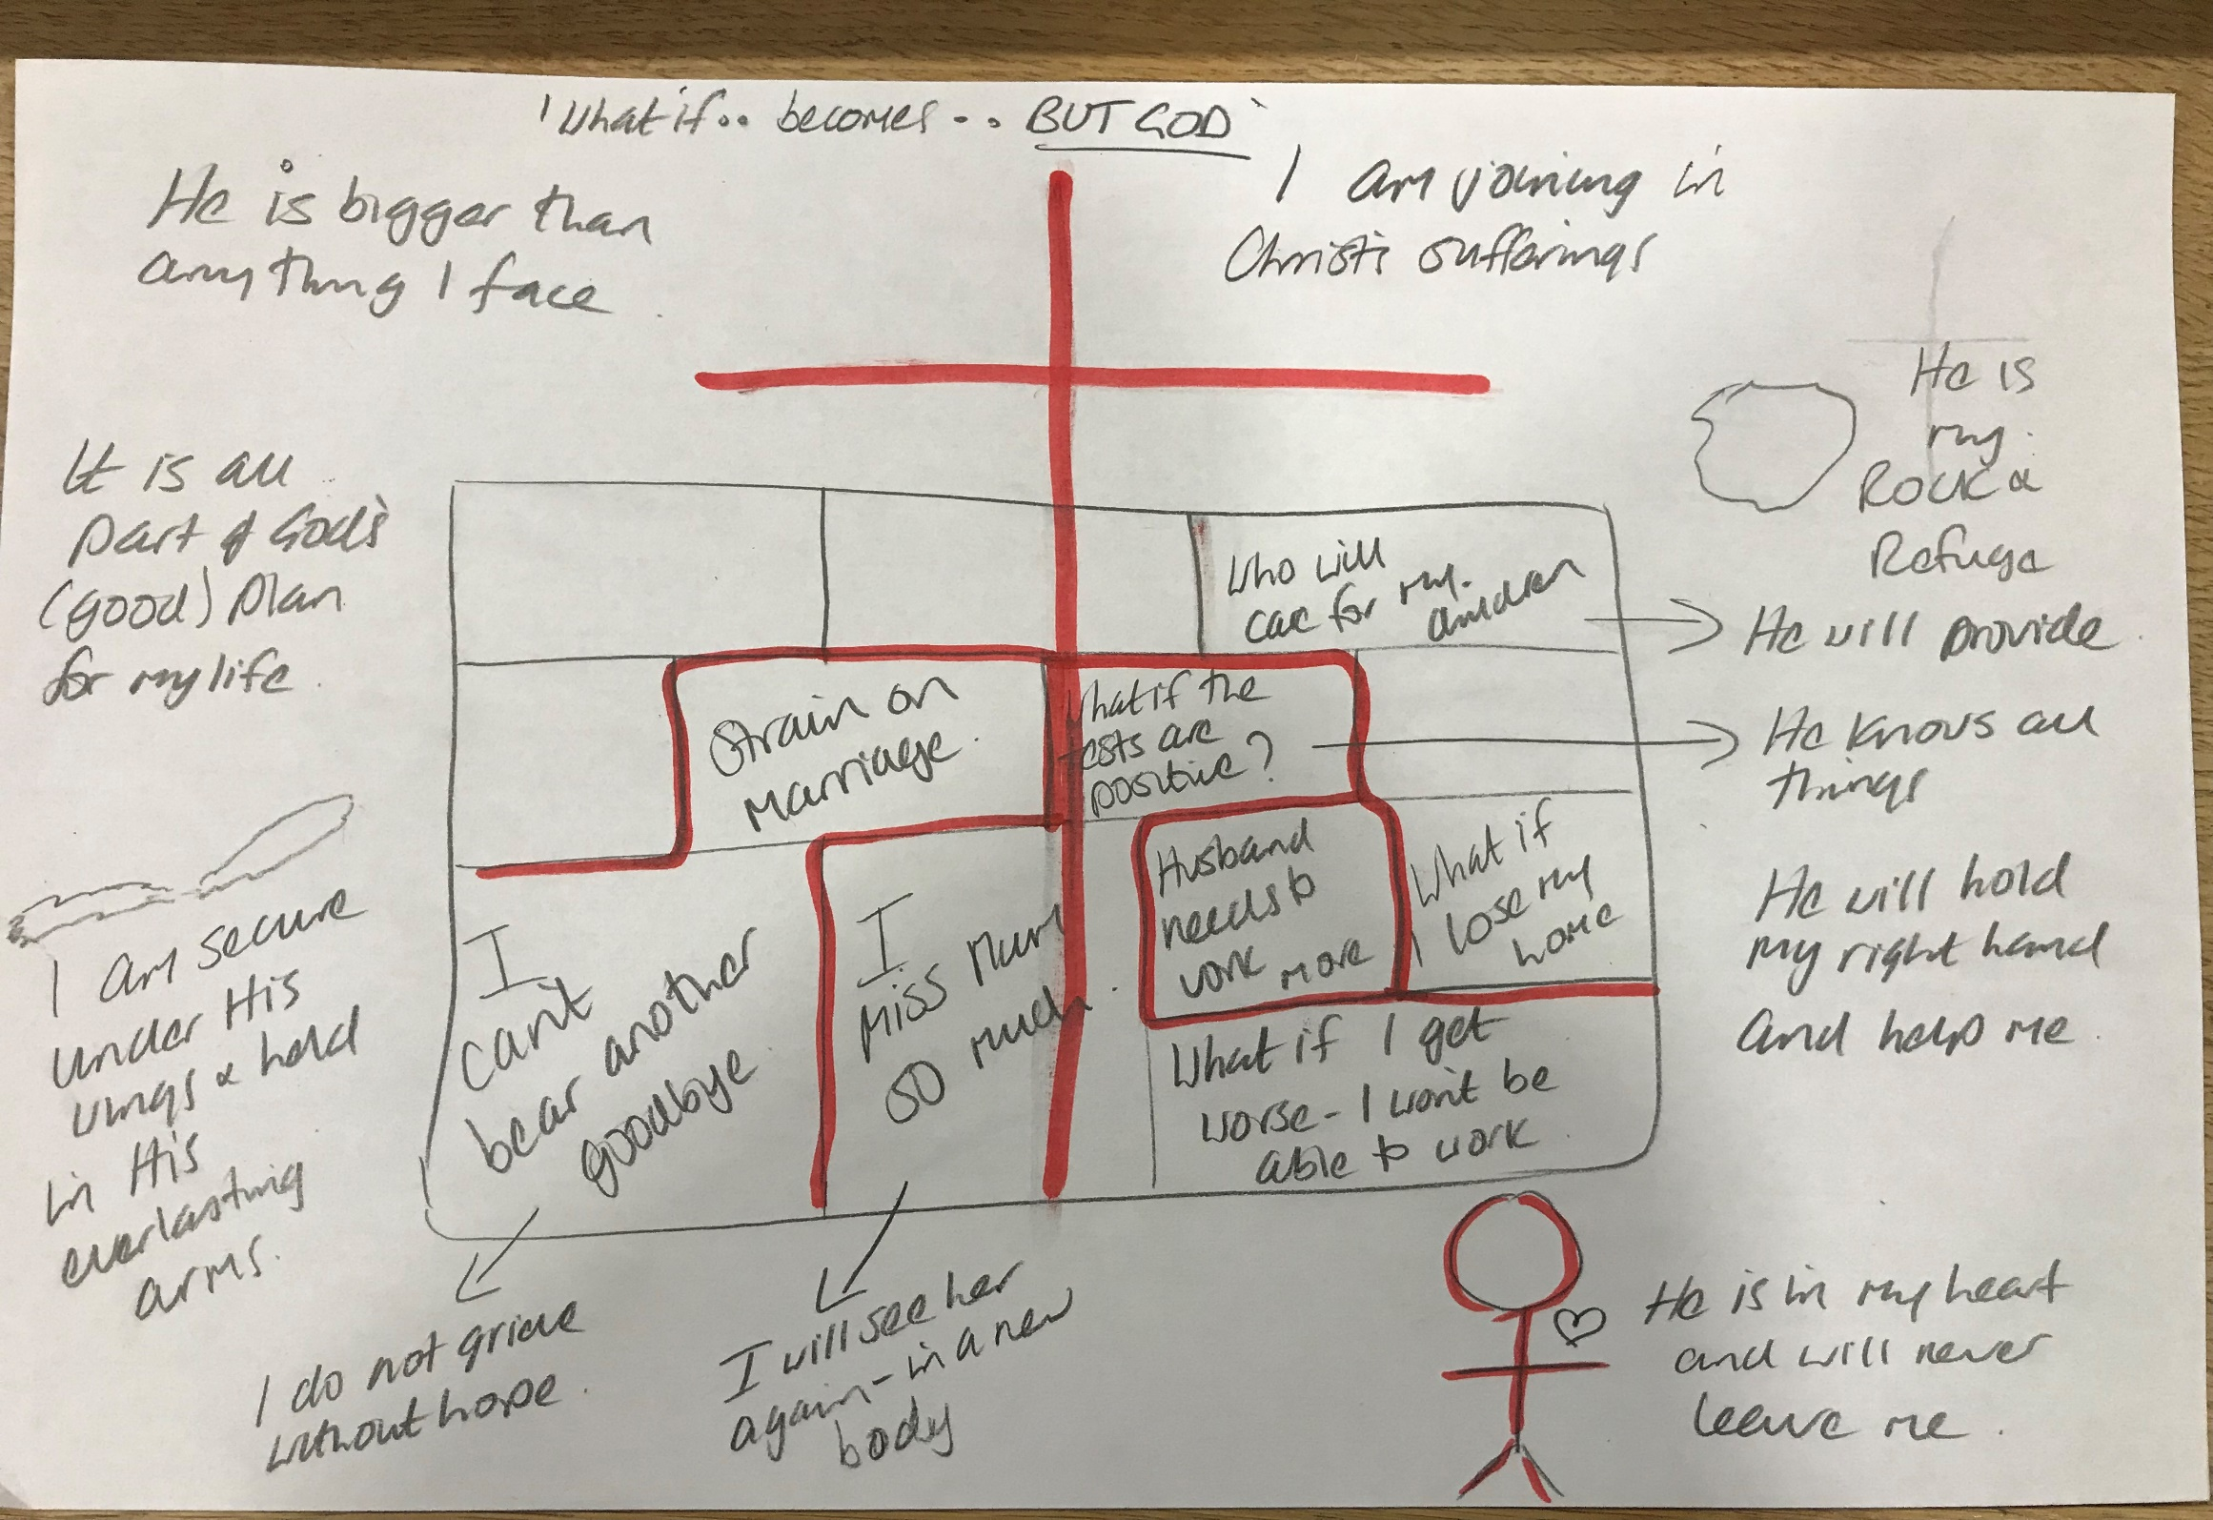

Slide 31
catherine@the-cornerstone.net
www.the-cornerstone.net
References:
‘SAD PERSONS’ Bird et al ‘Evaluation of Suicidal Patients: The SAD PERSONS scale’
‘NO HOPE’ Shea ‘Psychiatric interviewing: The art of understanding’
Aaron Sironi & Michael R. Emlet ‘Evaluating a person with suicidal desires’
Mike Emlet ‘Descriptions & Prescriptions’
Ed Welch ‘Blame it on the brain?’
Kathryn Green-McCreight ‘Darkness Is My Only Companion’
Nicholls & Thorne ‘Real Change’
Tim Lane ‘ Unstuck’

